Slide 1
TVS CREDIT
LOAN DEFAULT STATUS PREDICTION

Slide 2
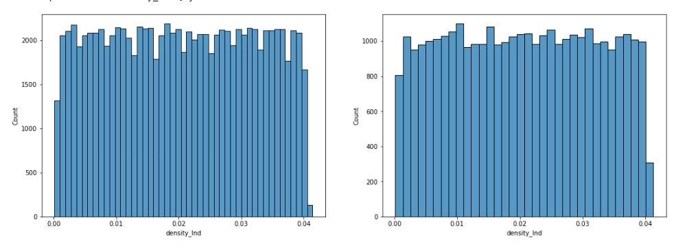
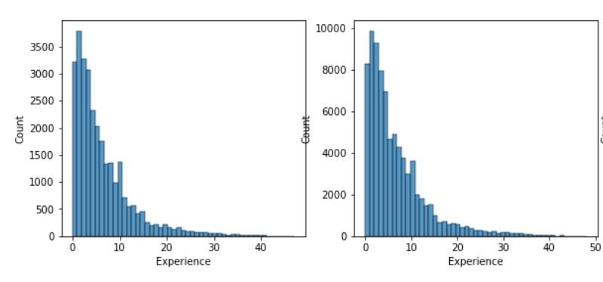
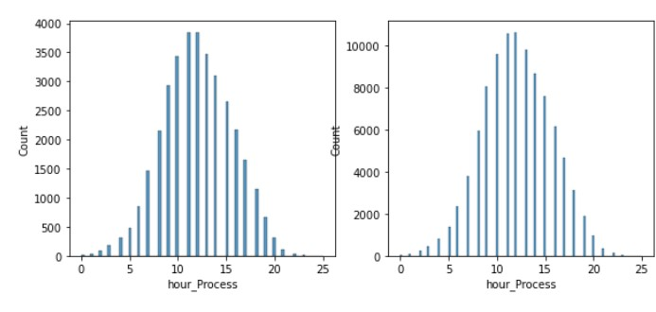
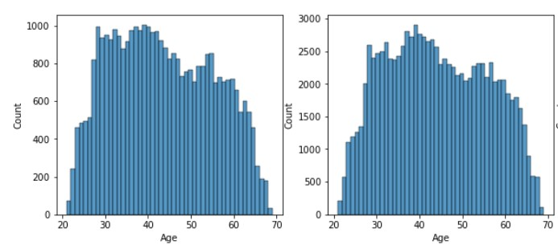
In MANY FEATURES WE CAN SEE THAT THE DISTRIBUTION OF DATA WITH RESPECT TO LOAN DEFAULT STATUS IS ALMOST SYMMETRICAL.
Uniform distribution can be observed in the density feature
Not Defaulted Defaulted
Not Defaulted Defaulted

Slide 3
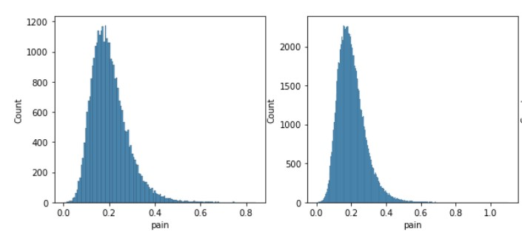
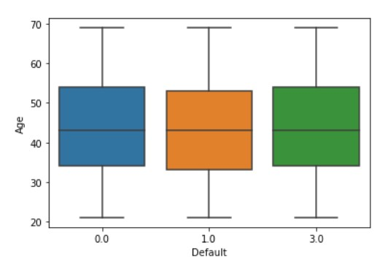
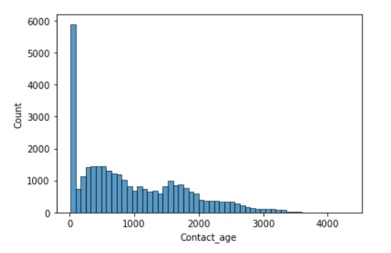
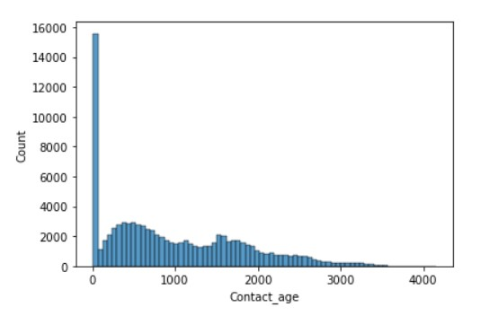
Not Defaulted Defaulted
The AGE quartiles are almost similar for both Defaulters and non – defaulters.

Slide 4
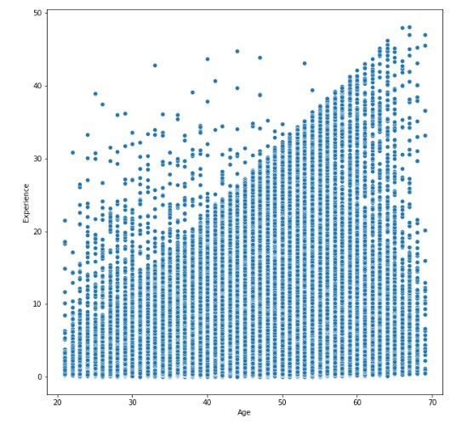
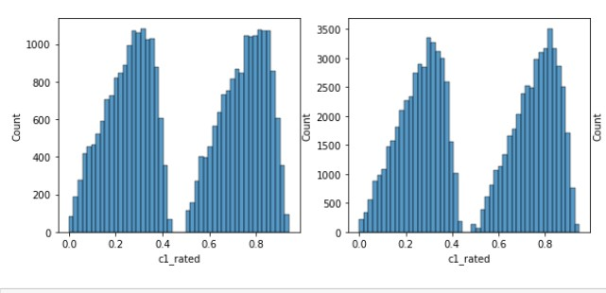
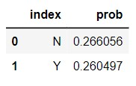
ANOMALY
How can a person’s experience be higher than his/her age?
We can observe a few records that their experience is higher than their age.
some new features were created
Tenure – number of years created from dividing the loan amount by the annuity amount.
Pain – compensation amount was divided by annuity amount to create pain feature.
One of the credit score column was dropped after using it to fill the other credit score column.
Not Defaulted Defaulted
The credit score feature has a bi modal distribution .
A distribution with two peaks.

Slide 5
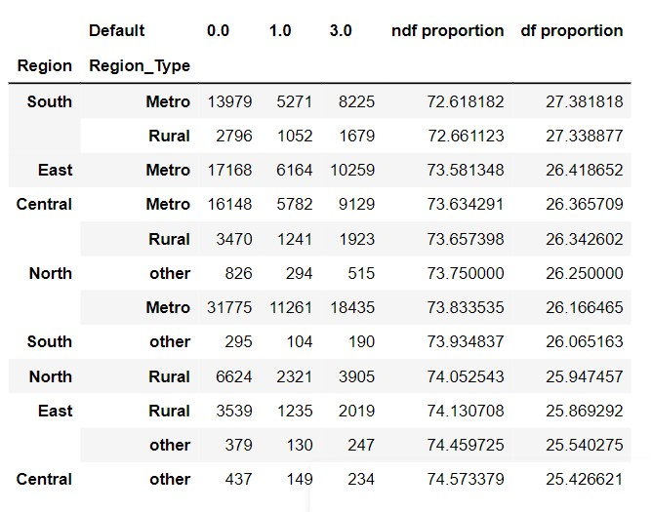
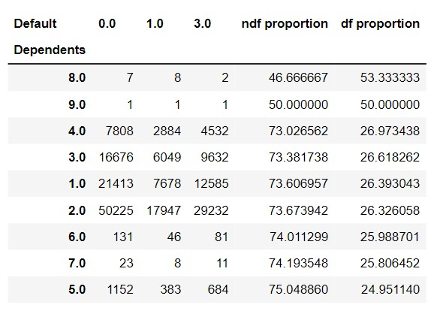
NOTE : All the probability mentions are relative probability (one vs another )
We could say from the pivot table that Clients from the south metro and south rural region have a higher probability of defaulting their loan payments.
In contrast clients from Central other region and East other regions have the least probability on defaulting their loan payments.
The majority of clients are falling in the 1- 4 dependents category.
With these 4 categories we do not observe many variations in the proportion of clients falling under the loan defaulters category
In contrast clients falling under 5 dependents category have the least probability for defaulting their loan payments.

Slide 6
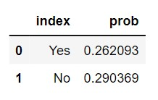
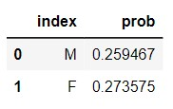
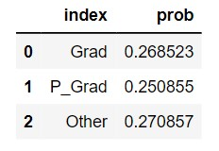
Permanent address
NOTE: All the probability mentions are relative probabilities within each features subcategories
Permanent address plays a key role as you can see the proportion of clients who have not provided their permanent address or do not have a permanent address are more likely to default on their loan payments compared to those who have given their permanent address.
This actually makes a lot of sense. Clients with permanent addresses cannot leave their residence or their place of living.
SEX
The proportion of females defaulting on their loan payments is higher compared to the proportion of males defaulting on their loan payments.
Due to gender inequality in most jobs females are usually paid less than their male peers.
Also average number of years a females work in a job is less compared to males.
Education details
Compared to graduates and postgraduates the proportion of clients in other education categories are more likely to default on their loan payments.
This could be due to their salary range difference, pay scale, and years hike that is more guaranteed and higher for Postgraduates followed by graduates.

Slide 7
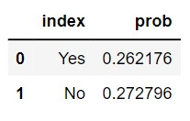
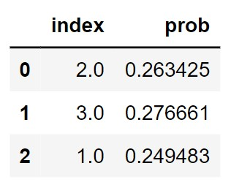
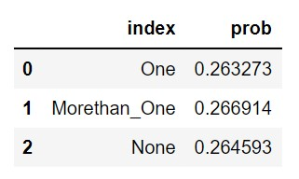
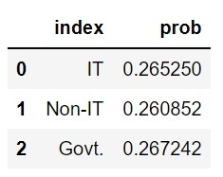
Phone number
Clients who give their phone numbers are less likely to default on their loan payments compared to clients who do not give their phone numbers
Company Rating
Clients who are in companies with the highest rating are more likely to default on their loans.
This could be due to their lifestyle, overestimation of their financial preferences and high risk-taking ability of high achievers who are generally preferred by top rated organizations.
Number of properties
Interestingly we can observe that clients with more than one property in their name are more likely to default on loan payments.
Job type
Clients from three job types are more equally likely to default on their loan.

Slide 8
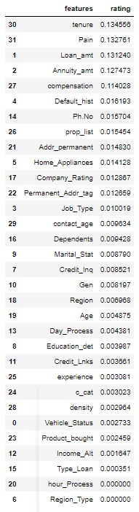
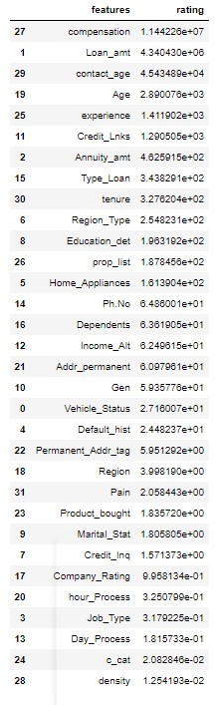
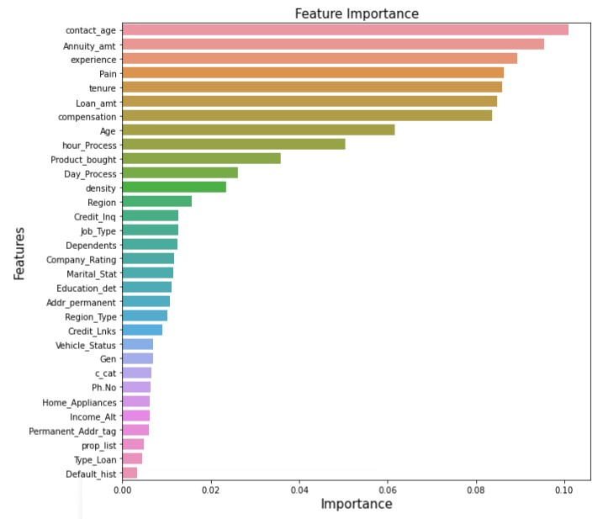
INFORMATION GAIN method
CHI2 method
FEATURE IMPORTANCE IS CALCULATED USING CHI2, INFORMATION GAIN, and RANDOM FOREST CLASSIFIER METHODS
By comparing the feature importance by building many models we can finalize on top 10 features that are more important in determining the loan default status.

Slide 9
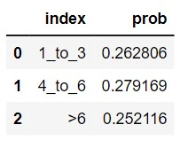
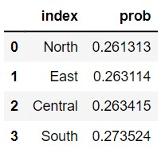
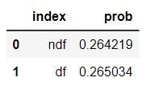
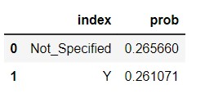
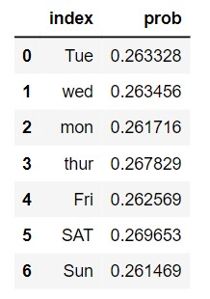
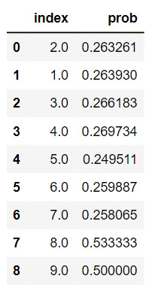
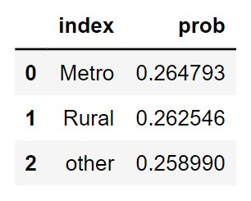
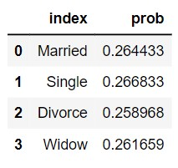
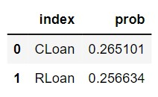
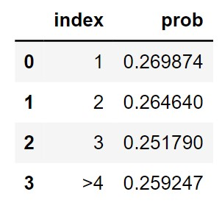
It is very interesting to observe how almost all subcategories are having a defaulter proportion number of around 0.26.
Tempted to Question the authenticity of the data.
Using pivot tables and analyzing the combination of multiple features will give more insights.
It has been carried out in the EDA notebook.

Slide 10
THANK YOU

